Slide 1
Price Prediction using
Neetin Verma
Long short-term memory (lstm)
Autoregressive Integrated Moving Average (arima)
GitHub Jupyter Notebook Link

Slide 2
Agenda
Objective
Data Visualization
Data Preprocessing and cleaning data
ML Model built and validation
Test set Prediction and measuring accuracy
Conclusion

Slide 3
Objective
The purpose of the project is to predict prediction stock price of stock using time series data.
The project also aims at building a model using LSTM & ARIMS techniques and find out the most suited predication
The data has features such as the Date, High, Open, Low, Adj Price, Volume . Models should learn from the data(Test & Train) and be able to predict the stock.

Slide 4
Long short-term memory (lstm)

Slide 5
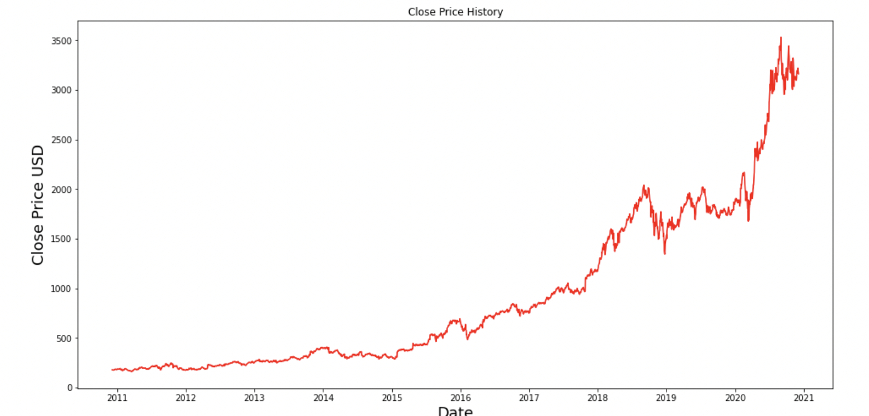
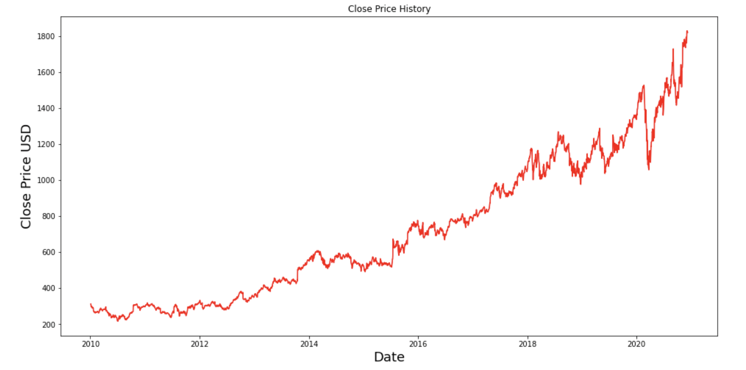
Data Visualization
Amazon dataset has 2518 records and 6 features.
Data range from 2011 to 2021.
Google dataset has 2752 records & 6 features
Data range from 2010 to 2020

Slide 6
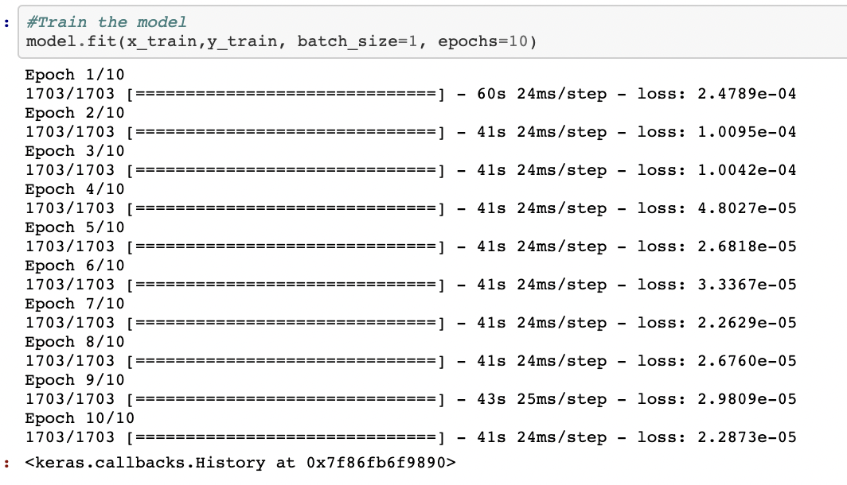
Train the dataset
Create the training dataset, Splitting the data into 70% training with 1 feature – “Close”
Scaled training dataset
Build the LSTM model
Train the model

Slide 7
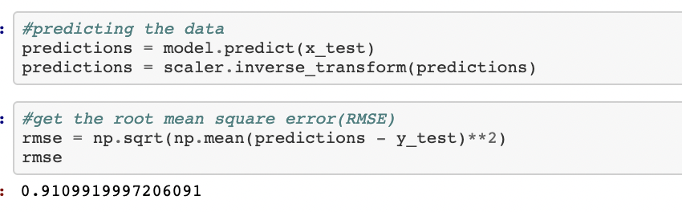
testing the dataset
Create the testing dataset, Splitting the data into 30% training with 1 feature – “Close”
Scaled training dataset
Predict the data
Find RMSE

Slide 8
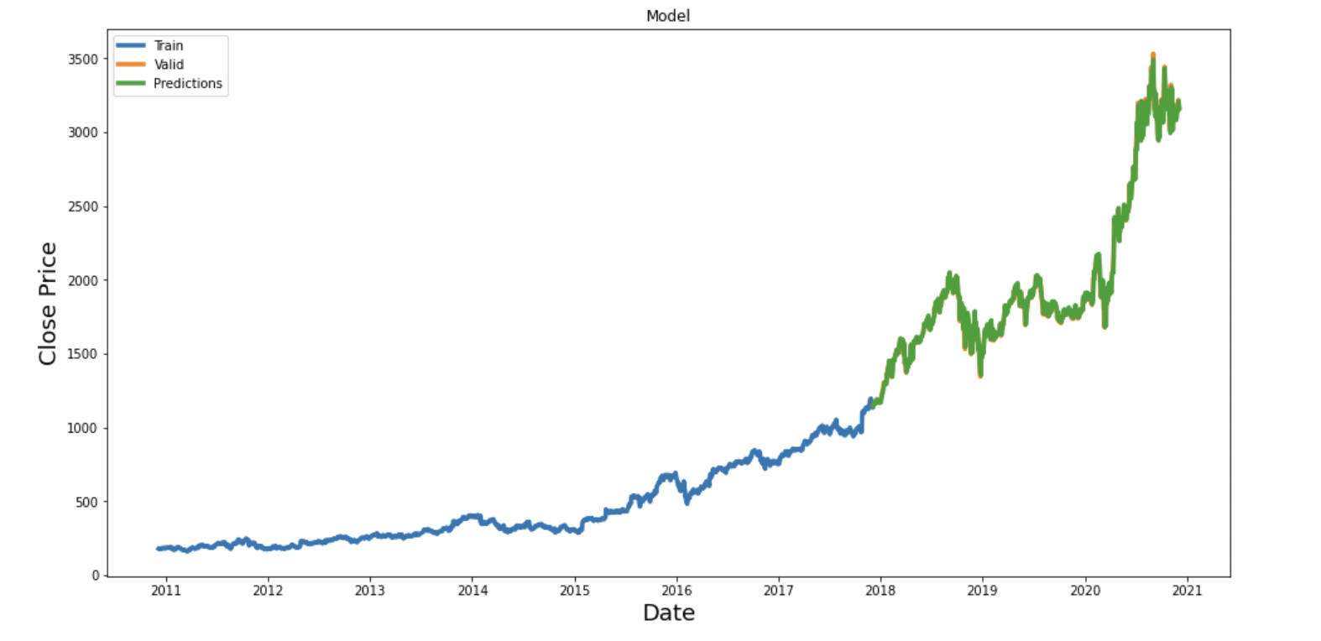
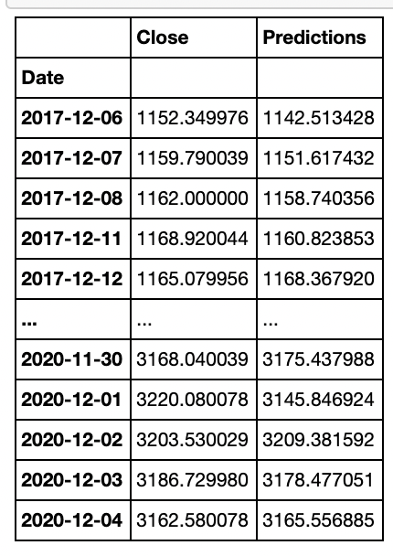
Data Visualization
Plot the Train, Valid & Prediction results.
Verify the actual close price with the prediction/model outcome.

Slide 9
ARIMA - The AutoRegressive Integrated Moving Average (ARIMA) model

Slide 10
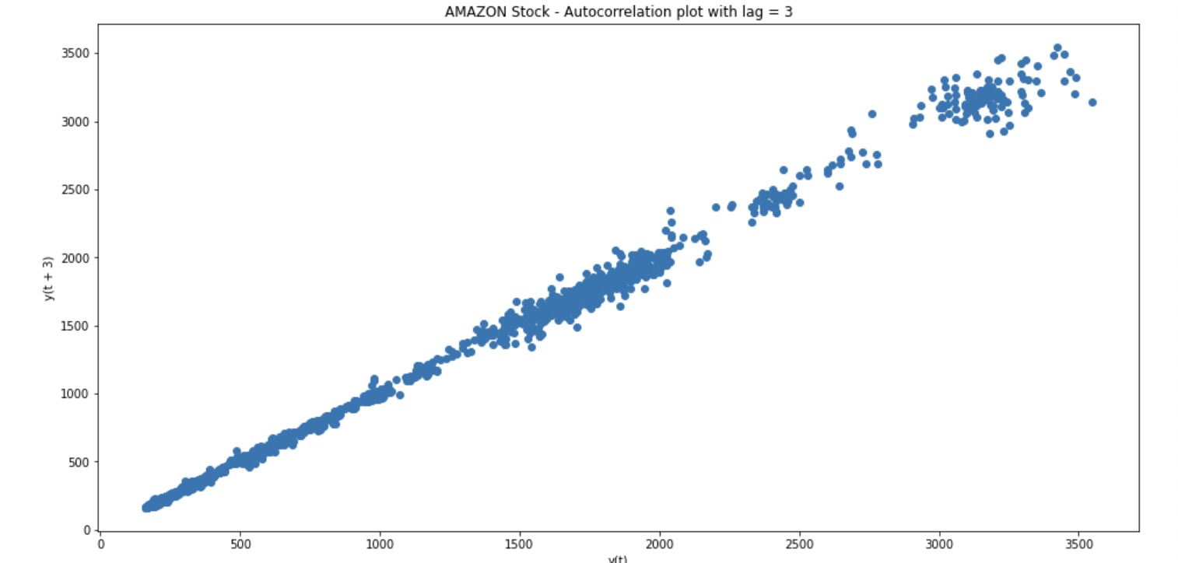
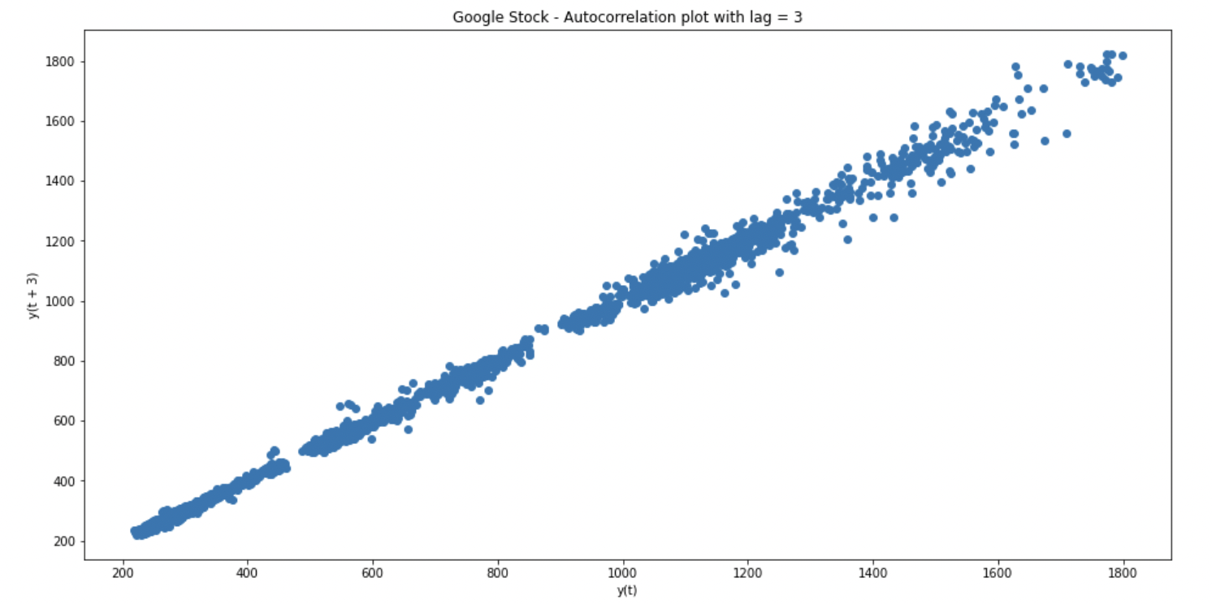
Data VISUALIZATION
Checking cross-correlation in our data.
We can now confirm that ARIMA is going to be a good model to be applied to this type of data (there is auto-correlation in the data).

Slide 11
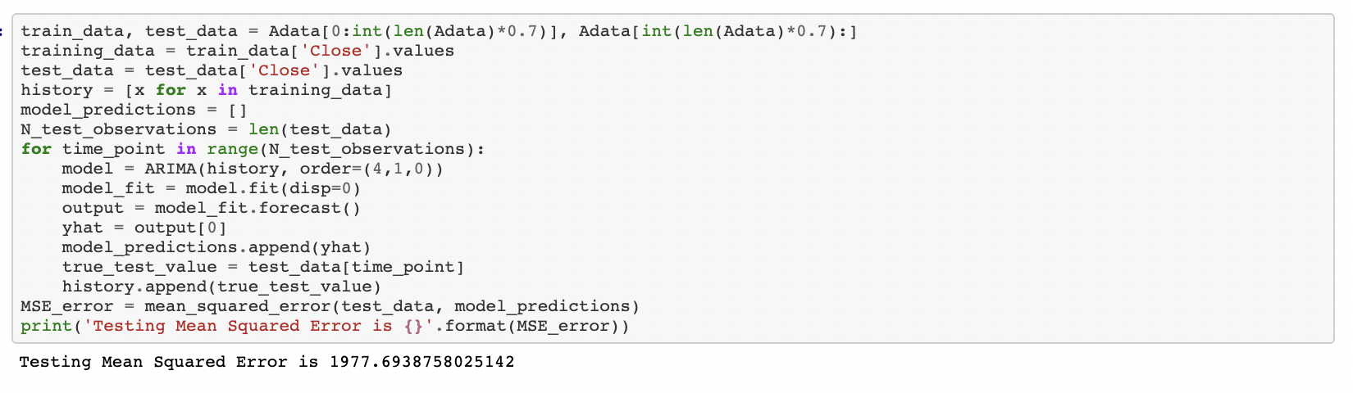
TRAIN(70%) & TEST(30%) THE DATA
ARIMA parameters: p=4, d=1 and q=0.
The MSE of the test set is quite large denoting that the precise prediction is a hard problem. However, this is the average squared value across all the test set predictions.

Slide 12
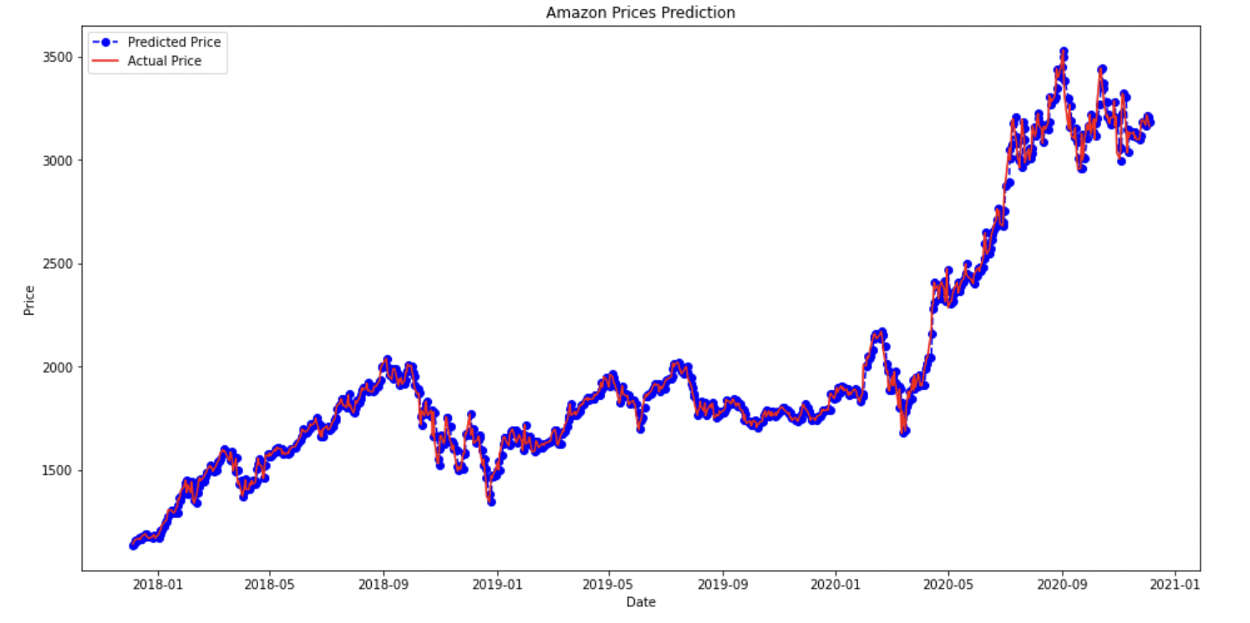
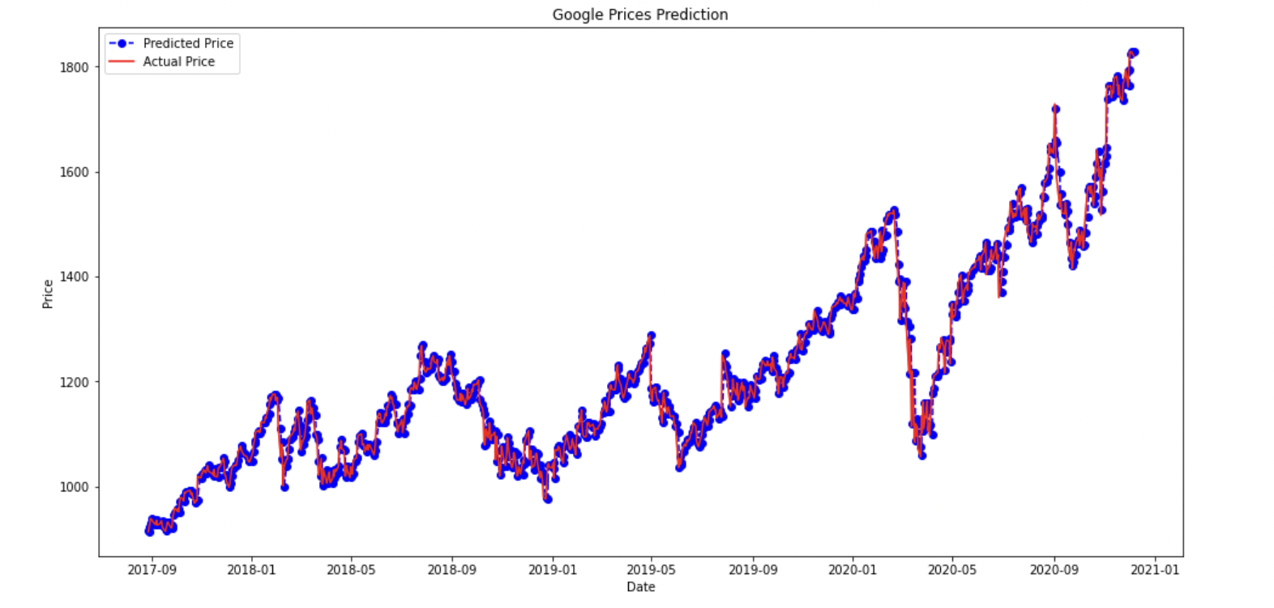
ARIMA model performance on the test set

Slide 13
Model Accuracy score
Stock | LSTM | ARIMA
Amazon | 0.9890319500700396 | 0.9936222183900572
Google | 0.9830930022158421 | 0.9855455121667532

Slide 14
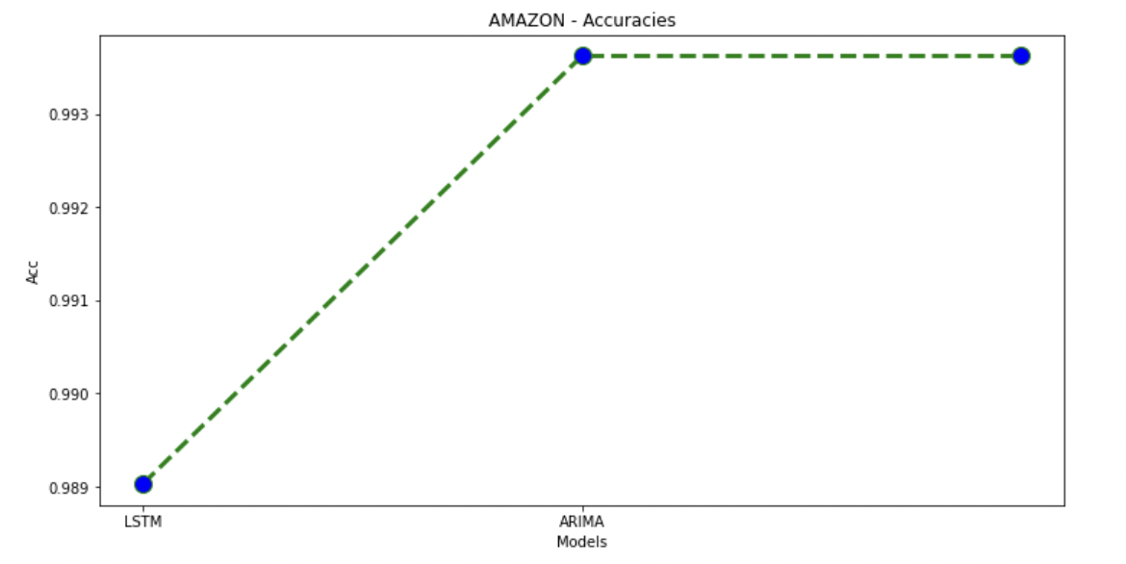
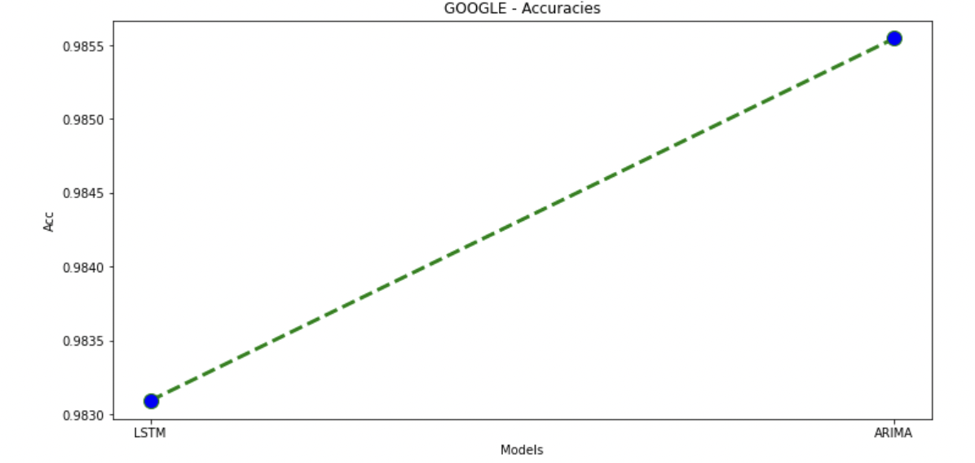
Accuracies

Slide 15
CONCULSION
For both AMAZON & GOOGLE, ARIMA model offers better prediction accuracy with respect to LSTM and is relatively fast as in terms of training/fitting time and complexity.
Based on ARIMA modelling outcome and prediction, GOOGLE is better Stock to buy than AMAZON

